Slide 1

Filename: HW#_StuID.zip
  Ex) HW3_Q123456.zip
Due: next Wed. 23:59:59
Introduction to Computers 1

Slide 2
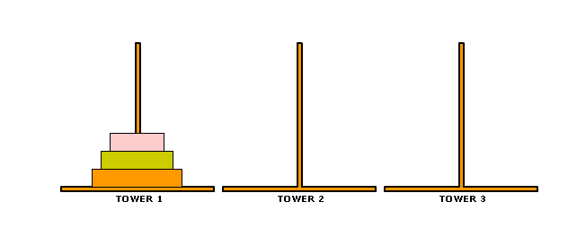
Tower of Honoi
There are three towers and several disks.
The disks are on Tower 1 at the beginning where larger disks are at the bottom and smaller disks are at the top.
The object of the game is to move all the disks over to Tower 3, but you cannot place a larger disk onto a smaller disk.
http://en.wikipedia.org/wiki/Tower_of_Hanoi
http://www.mathsisfun.com/games/towerofhanoi.html
Introduction to Computers 1

Slide 3
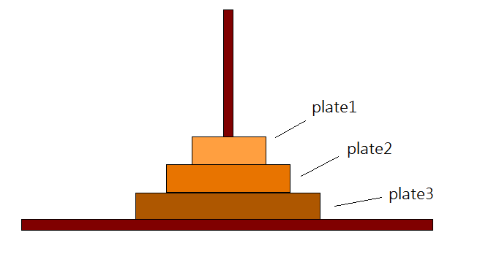
Users input number of disks at the beginning.
Show the initial settings on the screen.
  by text graph or simply text
Show all the moves on the screen
  Plate 1 move from tower 1 to tower 2
  Plate 2 move from tower 1 to tower 3
  …
Introduction to Computers 1

Slide 4
If all the disks are on Tower 3, print “WIN!”
Show your answers step by step.
Introduction to Computers 1

